Slide 1


Activation Function

Slide 2


Controls Neuron’s Output
Controls Neuron’s Learning

Slide 3
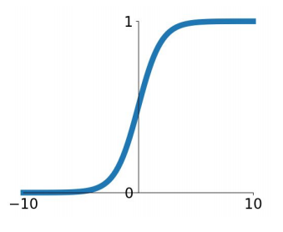
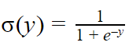
Sigmoid Function
Squashes output between 0 and 1
Nice interpretation i.e neuron firing or not firing
It has 3 problems.

Slide 4
Sigmoid Function
Problem 1
Vanishing Gradient
Derivative is zero when x> 5 or x <-5
Weights will not change
No Learning

Slide 5
Sigmoid Function
Problem 2
Output is not Zero-centered
Only positive numbers to Next layer

Slide 6
Sigmoid Function
Problem 3
e^{y} is compute expensive

Slide 7
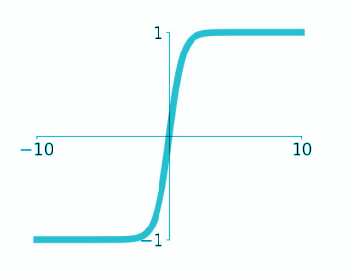
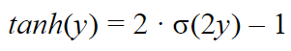
tanh
1. Zero-centered
2. Vanishing gradient
3. Compute expensive
hyperbolic tangent

Slide 8
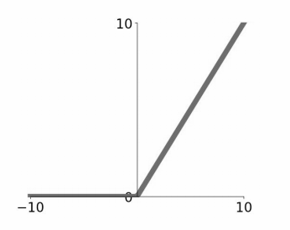
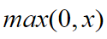
Rectified Linear Unit (ReLU)
1. Does not kill gradient (x>0)
2. Compute inexpensive
3. Converges faster
4. No Zero-centered output

Slide 9
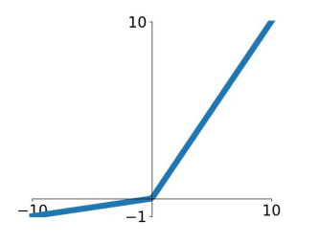
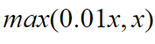
Leaky ReLU
1. Does not kill gradient
2. Compute inexpensive
3. Converges faster
4. Somewhat Zero-centered

Slide 10
Which one should we use?

Slide 11
Use ReLU
Try out Leaky ReLU
Try out tanh but don’t expect much
Minimize use of Sigmoid

Slide 12

Learning Rate

Slide 13
Very high rate
Visualizing Learning Rate
Loss
Low rate
High rate
Good rate
Number of iterations

Slide 14
Learning rate decay

Slide 15


Slide 16
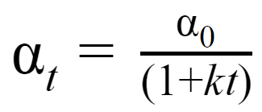
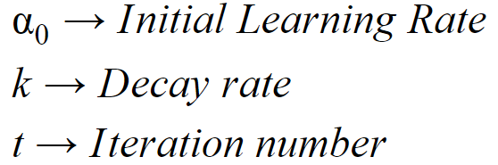
Time based learning rate decay
sgd_optimizer = tf.keras.optimizers.SGD(lr=0.1, decay=0.001)
model.compile(optimizer=sgd_optimiser, loss='mse’)

Slide 17


Memorizing
vs
Learning

Slide 18
Overfitting
Training Accuracy
Model Accuracy
Big Gap
Test Accuracy
Number of iterations

Slide 19
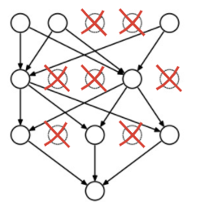
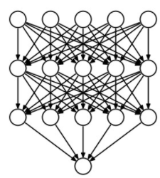
Dropout
Drop=50%
Prediction keep=100%

Slide 20
Dropout
model.add(tf.keras.layers.Dropout(0.4)
model.add(tf.keras.layers.Dense(200))
model.add(tf.keras.layers.Dropout(0.4))
model.add(tf.keras.layers.Dense(100))

Slide 21

Batch Normalization

Slide 22
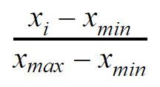
Min-Max Scaler
Every value is between 0 and 1 after normalization

Slide 23
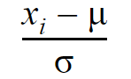
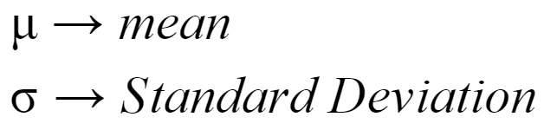
z-Score Normalization
Mean is 0 and Variance is 1 after normalization

Slide 24
Normalizing data in Deep Learning with
mini-batching

Slide 25
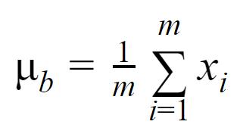
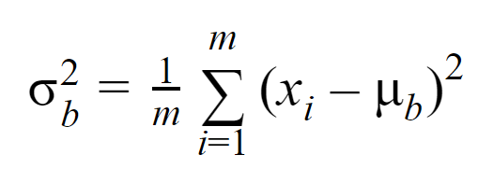
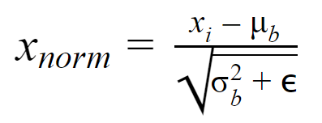
1. Calculate mean for a batch
2. Calculate Variance for the batch
3. Normalize
Batch Normalization

Slide 26
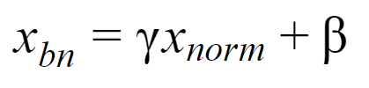
1. Scale and Shift
Batch Normalization

Slide 27
Where to use Batch Normalization?
With hidden layers

Slide 28
Input
Output
Hidden Layers

Slide 29

Optimizers

Slide 30
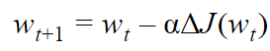
New Weight
Learning Rate
Loss function
Stochastic Gradient Descent (SGD)

Slide 31

Loss function is Complex
Local Minima
Saddle point
Very common in high dimension

Slide 32
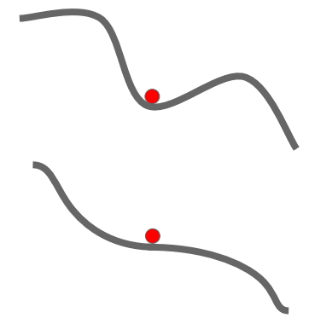
Problem with SGD
Zero gradient
SGD gets stuck

Slide 33

Momentum

Slide 34
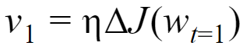
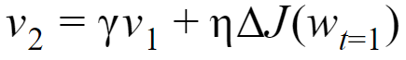
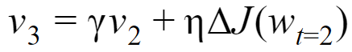
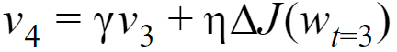
1
2
Momentum
3
4

Slide 35
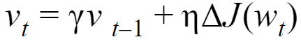
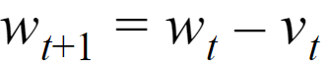
Momentum
Gradient with Momentum
momentum
New weight

Slide 36
sgd = tf.keras.optimizers.SGD(lr=0.03, momentum=0.9)

Slide 37
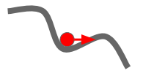
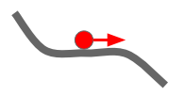
What happens to Saddle point and local minima?

Slide 38
Can that be a problem?

Slide 39
Can we check what’s in future?

Slide 40
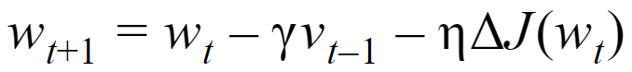
How to check things in future?
Gives us some idea about future

Slide 41
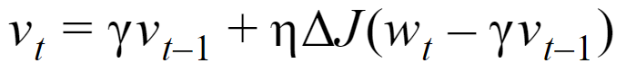
Nesterov Momentum
Adjusted Momentum

Slide 42
sgd = tf.keras.optimizers.SGD(lr=0.03, momentum=0.9, nestrove=True)

Slide 43

Why should all weights use same Learning Rate?

Slide 44
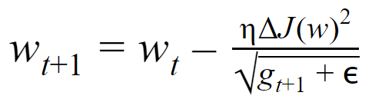
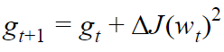
Adagrad
Adapts or changes learning rate for each weight
Add Squared Gradient to past Gradients
Learning Rate is different at each step for each weight

Slide 45
Adagrad
No need to adjust Learning Rate
Learning Rate is always decaying

Slide 46
model.compile(optimizer=’adagrad’, loss=’categorical_crossentropy’, metrics=[‘accuracy’])

Slide 47
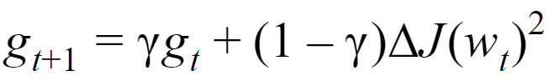
AdaDelta
Keeps decaying mean for all past squared gradients
Decaying mean of Squared Gradients
Learning Rate is different at each step for each weight

Slide 48
Anything else we can do?

Slide 49
Keeps track of past Squared Gradients
Keeps track of past Gradients
Adam
Adaptive Moment Estimation

Slide 50
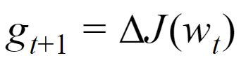
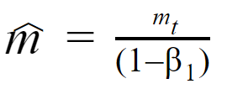
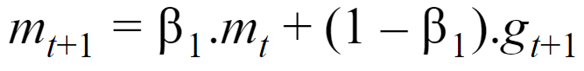
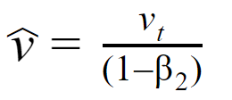
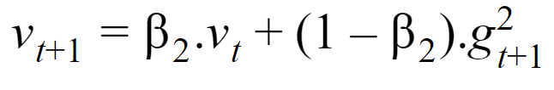
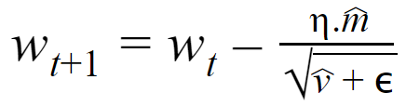
Calculate Gradient
Bias-corrected First moment
First moment - past Gradients
Bias-corrected Second moment
Second moment, past squared Gradients
New Weight

Slide 51
model.compile(optimizer=’adam’, loss=’categorical_crossentropy’, metrics=[‘accuracy’])

Slide 52
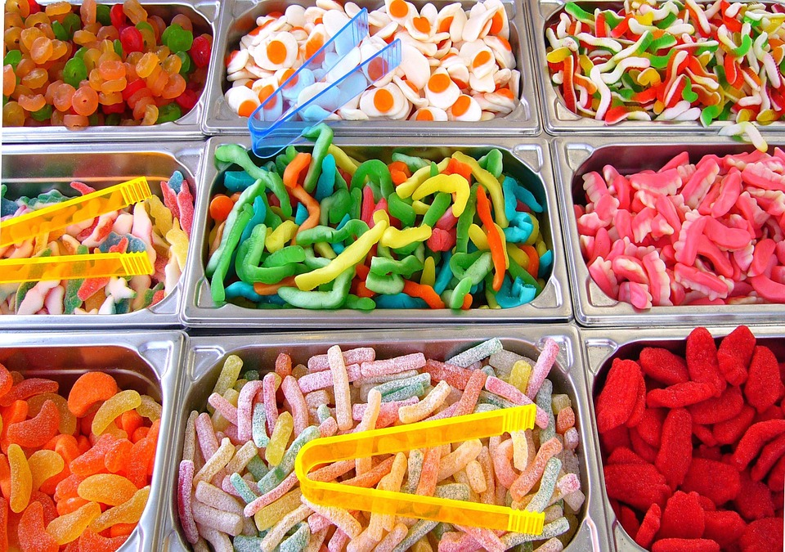
Hyper-Parameters
in
Deep Learning

Slide 53

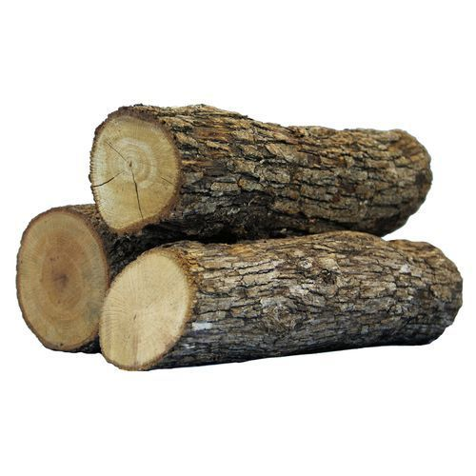

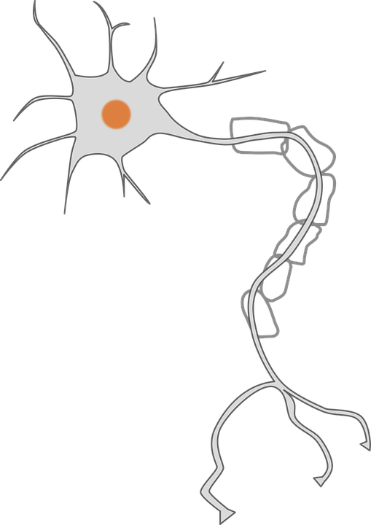
# of iterations
Batch Size
Learning Rate
Learning rate decay
# of Hidden Layers
# of Neurons in each Layer
Activation functions
Dropout
Optimizers

